Slide 1
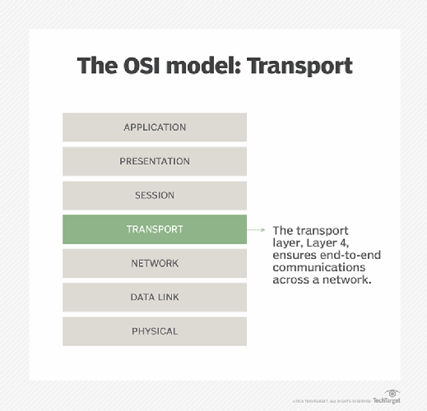
Lec -33
Transport Layer

Slide 2
What is Transport Layer?
The transport layer provides services to the application layer and takes services from the network layer.
The data in the transport layer is in the form of Segments. It is responsible for the End to end-to-end delivery of the complete message.
The transport layer also provides the acknowledgment of the successful data transmission and re-transmits the data if an error is found.

Slide 3
PROCESS-TO-PROCESS DELIVERY.
The transport layer is responsible for process-to-process delivery—delivering a packet, part of a message, from one process to another. As we will see later, two processes communicate in a client/server relationship.

Slide 4
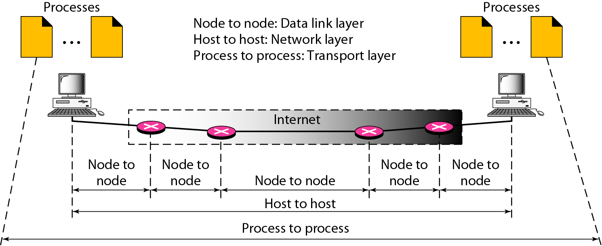
Types of data deliveries.

Slide 5
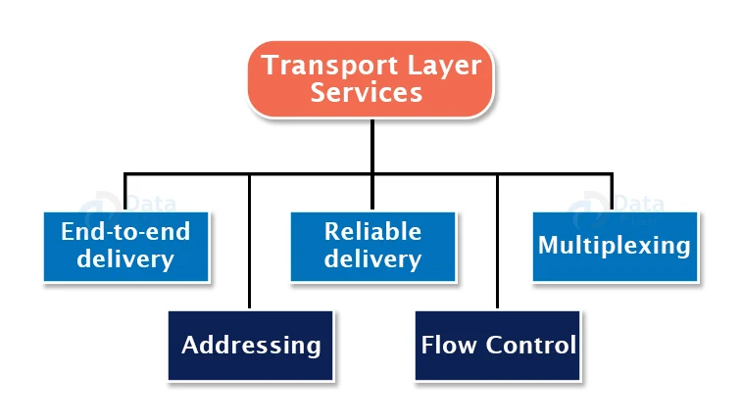
Services of Transport Layer.

Slide 6
Services Provide by Transport Layer.
End-to-end delivery: -
The complete message is sent to the destination by the transport layer. As a result, it secures the complete transport of a message from source to destination.
2. Addressing: -According to the tiered model, the transport layer interacts with the session layer’s functions Many protocols integrate session, presentation, and application layer protocols into a single application layer. In these situations, delivery to the session layer entails delivery to the application layer. Data created by one program on one system must be sent to the appropriate application on another machine. The transport layer provides addressing in this scenario.

Slide 7
3. Reliable delivery: -
By retransmitting missing and broken packets, the transport layer provides reliability services.
There are 4 dimensions to reliable delivery:
a. Error Control:
Error Control is the basic function of dependability. In truth, no transmission will be completely error-free. As a result, transport layer protocols are built to ensure error-free transmission.
The error handling technique is likewise provided by the data connection layer, although it only assures node-to-node error-free transmission. However, node-to-node dependability does not guarantee end-to-end dependability.

Slide 8
b. Sequence Control: -
The second part of reliability is sequence control, which is done at the transport layer.
On the transmitting end, the transport layer is responsible for guaranteeing that packets received from the upper levels may be utilized by the lower layers. It guarantees that the various portions of a transmission may be accurately reassembled on the receiving end.
c. Loss Control: -
A third facet of reliability is loss control. The transport layer guarantees that all fragments of a transmission, not just portions of them, arrive at their destination. A transport layer assigns sequence numbers to all transmission pieces on the transmitting end. These sequence numbers help the transport layer of the receiver to identify the missing segment.
d. Duplication Control: -
The fourth component of reliability is duplication control. The transport layer ensures that no duplicate data is delivered to the destination. Sequence numbers are used to detect missing packets, as well as to identify and delete duplicate segments by the receiver.

Slide 9
Flow Control:
The use of flow control prevents the transmitter from overloading the recipient. If the receiver becomes overwhelmed with data, it discards the packets and requests that they be retransmitted. This increases network congestion and, as a result, reduces system performance.
Flow control is handled by the transport layer. It employs the sliding window protocol, which increases the efficiency of data transmission while also controlling the flow of data so that the receiver is not overburdened. The sliding window protocol is byte-oriented as opposed to frame-oriented.

Slide 10
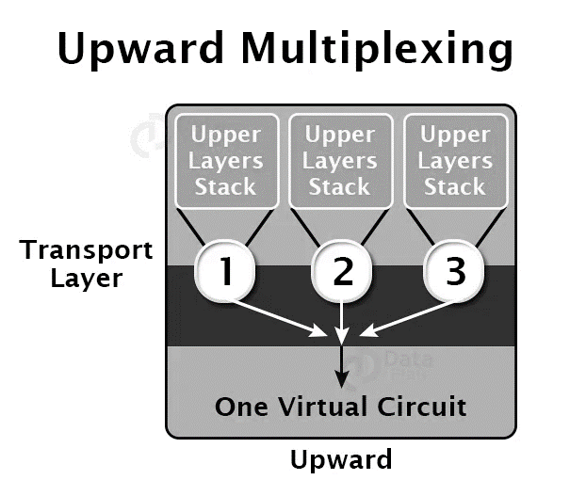
5. Multiplexing: - There are two types of multiplexing:

Slide 11
Upward multiplexing is defined as the Multiple transport layer connections using the same network connection are referred to as upward multiplexing.
The transport layer delivers numerous transmissions intended for the same destination along the same channel to save costs; this is accomplished by upward multiplexing.

Slide 12
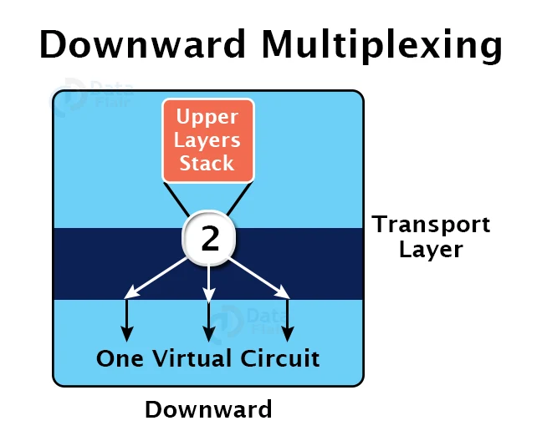
Downward Multiplexing.
Downward multiplexing refers to the usage of several network connections using a single transport layer link. It allows the transport layer to divide a connection across numerous pathways in order to increase throughput. When networks have a limited or sluggish capacity, this sort of multiplexing is utilized.

Slide 13
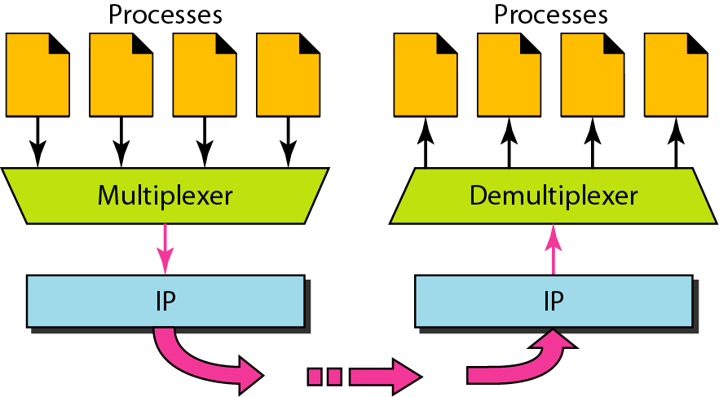
Multiplexer and Demultiplexer.

Slide 14
IANA Ranges
lANA Ranges
The lANA (Internet Assigned Number Authority) has divided the port numbers into
three ranges: well known, registered, and dynamic (or private)
o Well-known ports.
The ports ranging from 0 to 1023 are assigned and controlled
by lANA. These are the well-known ports.
Registered ports. The ports ranging from 1024 to 49,151 are not assigned or controlled
by lANA.
Dynamic ports. The ports ranging from 49,152 to 65,535 are neither controlled
nor registered. They can be used by any process. These are the ephemeral ports

Slide 15
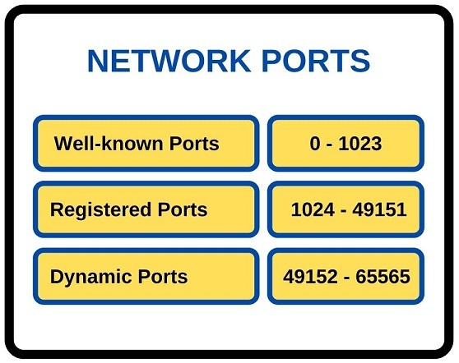
Types of Network Ports .

Slide 16
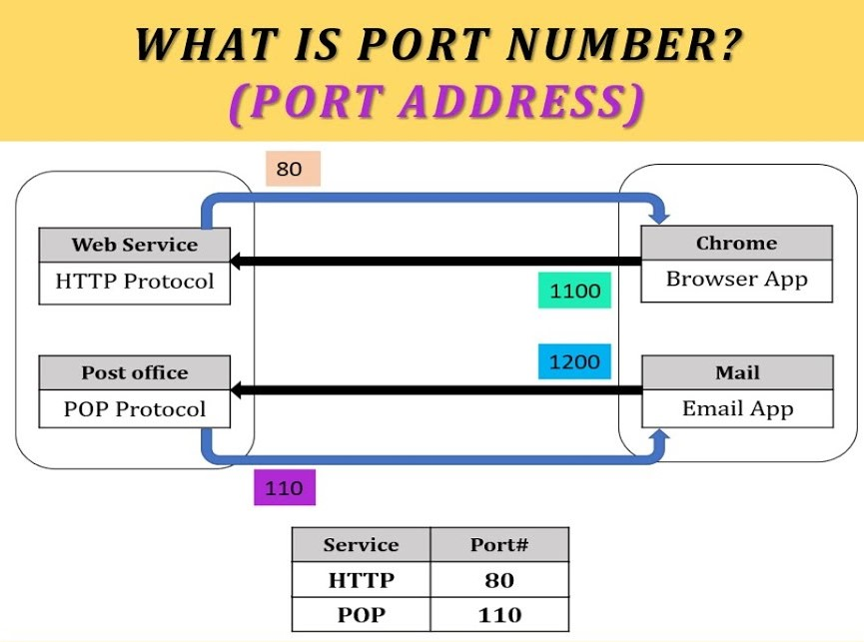
How does the port number work?

Slide 17
Well-Known Ports - Some of these port numbers are well-known ports. These well-known ports are the reserved ports between 0 and 1024. The full list of these network port numbers is given in RFC 1700. IANA (Internet Assigned Numbers Authority) assigns these well-known ports.
Network Ports - The other network ports are registered ports between 1024 and 49151. These ports are re-assigned by IANA for specific services.
The last part of ports in networking are dynamic ports. Dynamic ports are the ports from 49152 to 65565. These ports in networking are not registered with IANA.

Slide 18
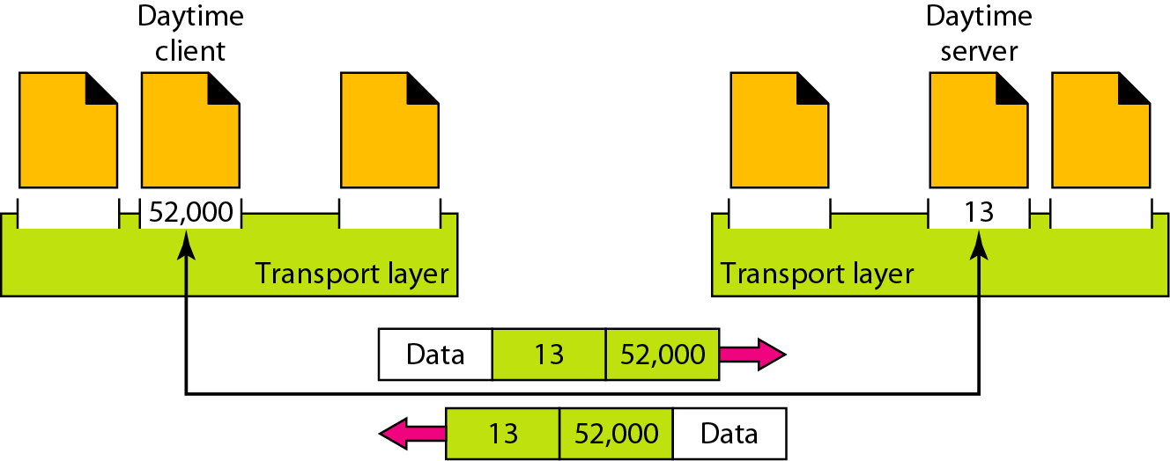
Figure 23.2 Port numbers

Slide 19
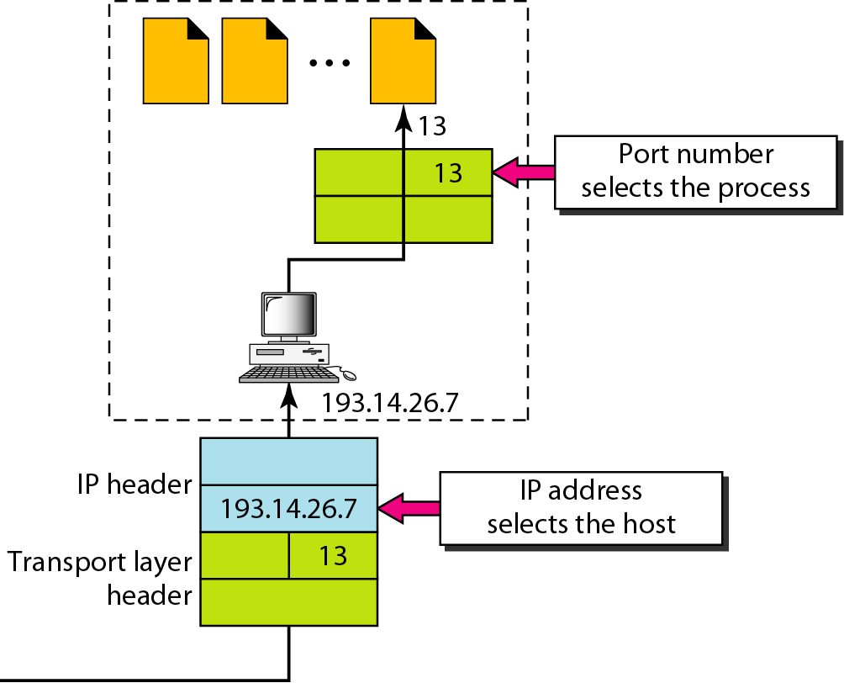
Figure 23.3 IP addresses versus port numbers

Slide 20
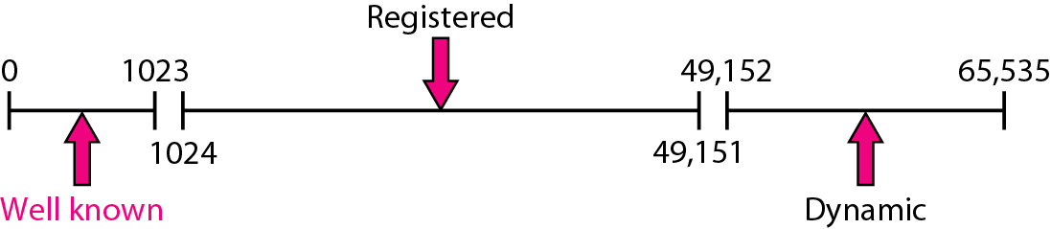
Figure 23.4 IANA ranges

Slide 21
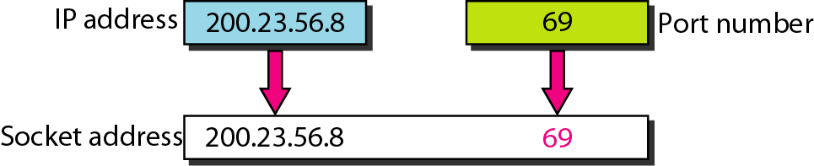
Figure 23.5 Socket address

Slide 22
In a host running a TCP/IP protocol suite, there is only one UDP but possibly several processes that may want to use the services of UDP.
To handle this situation, UDP multiplexes and demultiplexes.

Slide 23
Connectionless Versus Connection-Oriented Service.
Connectionless Service -:
In a connectionless service, the packets are sent from one party to another with no need for connection establishment or connection release. The packets are not numbered; they may be delayed or lost or may arrive out of sequence. There is no acknowledgment either. We will see shortly that one of the transport layer protocols in the Internet model, UDP, is connectionless.
Connection-Oriented Service -:
In a connection-oriented service, a connection is first established between the sender and the receiver. Data are transferred. In the end, the connection is released. TCP and SCTP are connection-oriented protocols.

Slide 24
Reliable Versus Unreliable.
The transport layer service can be reliable or unreliable. If the application layer program needs reliability, we use a reliable transport layer protocol by implementing flow and error control at the transport layer. This means a slower and more complex service.
On the other hand, if the application program does not need reliability because it uses its own flow and error control mechanism or it needs fast service or the nature of the service does not demand flow and error control (real-time applications), then an unreliable protocol can be used.
UDP is connectionless and unreliable; TCP and SCTP are connection-oriented and reliable.
These three can respond to the demands of the application layer programs.

Slide 25
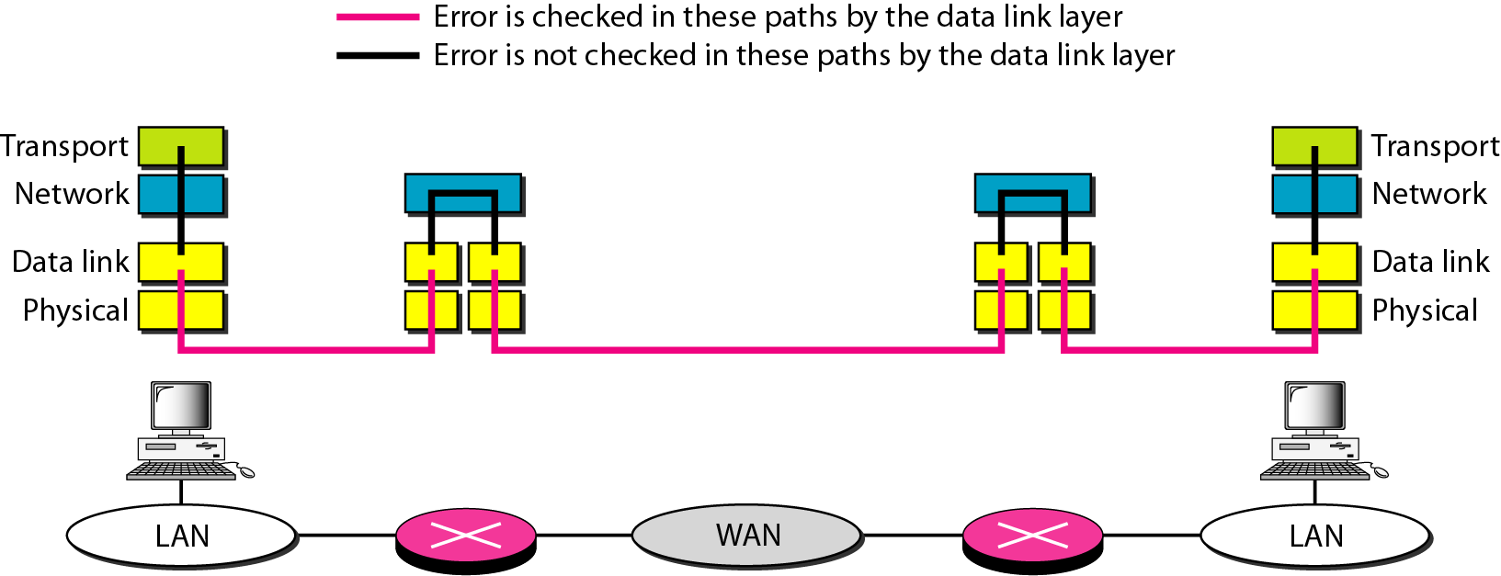
Figure 23.7 Error control

Slide 26
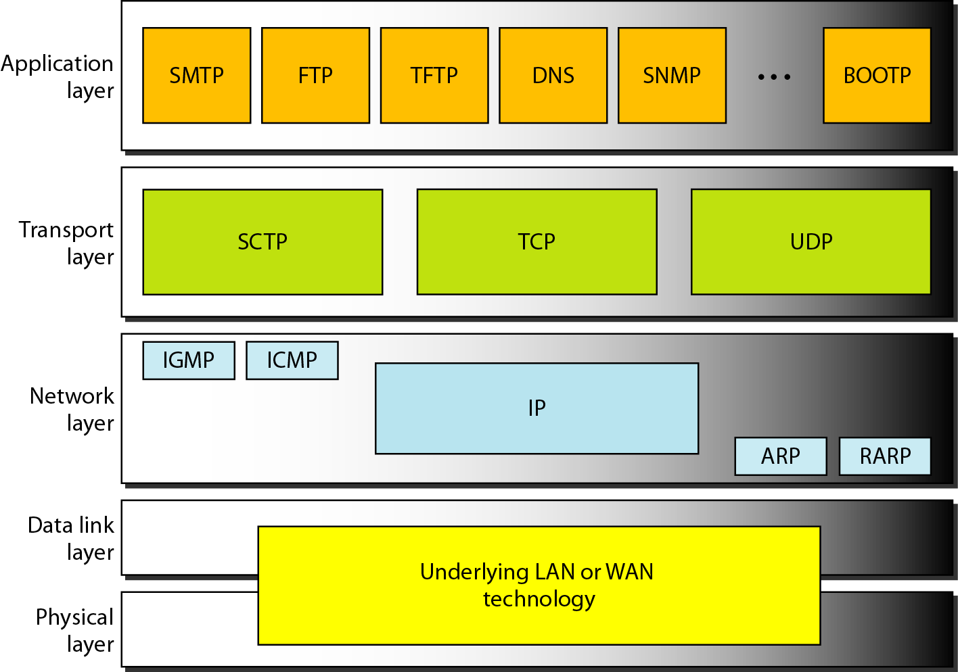
Figure 23.8 - Position of UDP, TCP, and SCTP in TCP/IP suite.

Slide 27
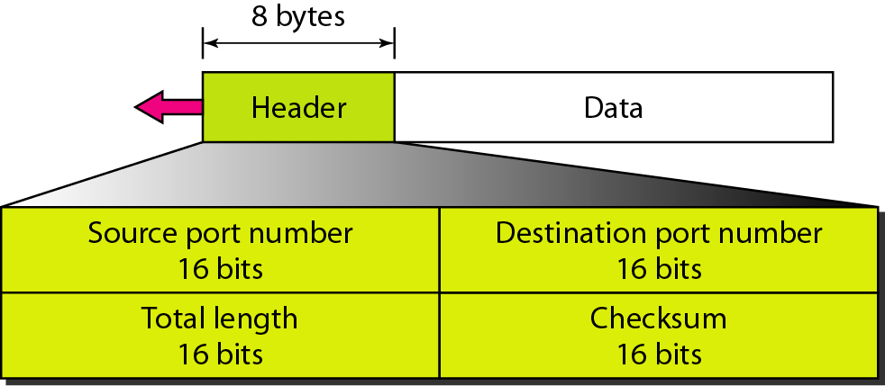
What IS USER DATAGRAM PROTOCOL (UDP) and User datagram format?
The User Datagram Protocol (UDP) is called a connectionless, unreliable transport protocol. It does not add anything to the services of IP except to provide process-to-process communication instead of host-to-host communication.

Slide 28
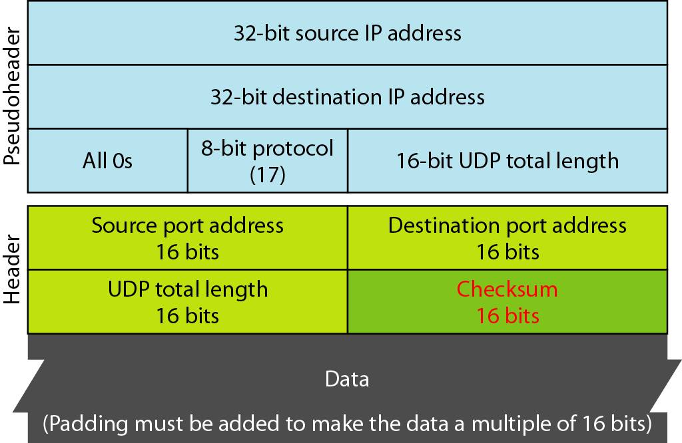
Figure 23.10 - Pseudoheader for checksum calculation.

Slide 29
UDP Operation.
Connectionless service- no relation between datagram, not numbered.
No Flow and error control- no flow control so no window mechanics.
No error control except checksum (silently discard packet) .
Encapsulation and decapsulation – IP Datagrams - To send a message from one process to another, the UDP protocol encapsulates and decapsulates messages.

Slide 30
Uses of UDP.
Suitable for processes that require simple request-response communication with little concern for flow and error control.
Suitable for multicasting
Used for management processes such as SNMP
Used for routing updating protocol: RIP

Slide 31
Queuing
In UDP, queues are associated with ports.
At the client site, when a process starts, it requests a port number from the operating system. Some implementations create both an incoming and an outgoing queue associated with each process. Other implementations create only an incoming queue associated with each process.
Incoming and outgoing queue
It will obtain only one port number
Port unreachable icmp message (if queue is not created)

Slide 32
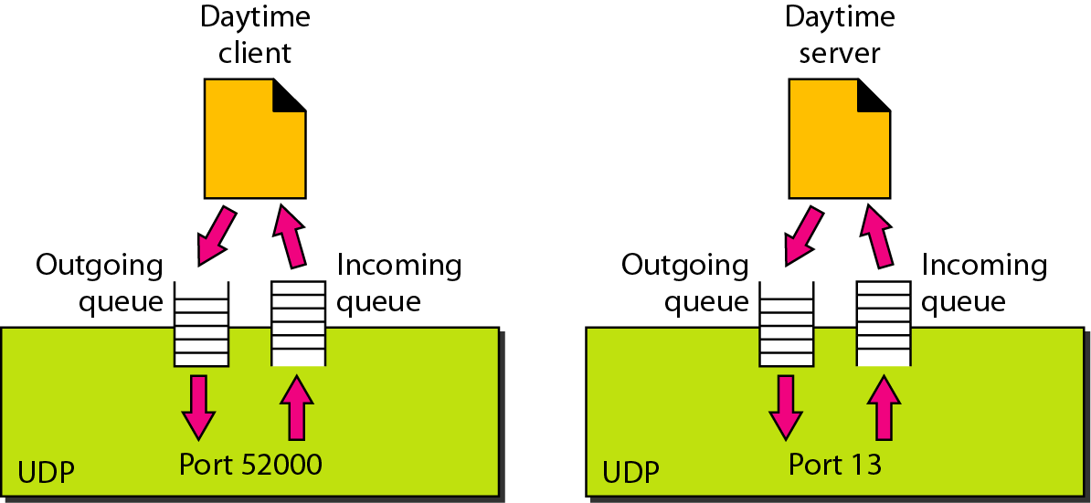
Figure 23.12 Queues in UDP

Slide 33
TCP
TCP is a connection-oriented protocol; it creates a virtual connection between two TCPs to send data. In addition, TCP uses flow and error control mechanisms at the transport level. TCP uses checksum (for error detection), retransmission of lost or corrupted packets, cumulative and selective acknowledgments, and timers.

Slide 34
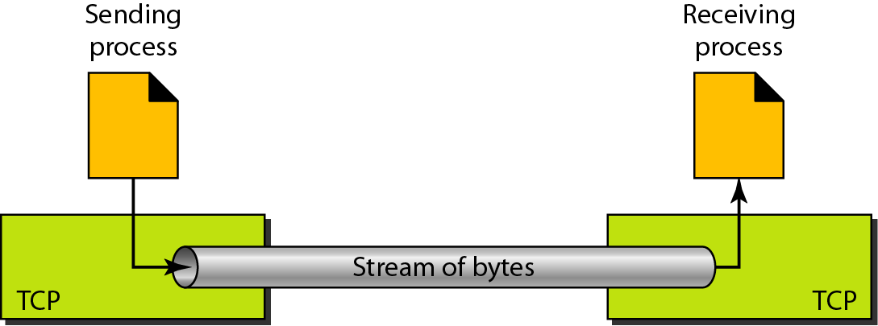
Figure 23.13 Stream delivery
TCP, unlike UDP, is a stream-oriented protocol. In UDP, a process sends messages with predefined boundaries to UDP for delivery.
UDP adds its own header to each of these messages and delivers it to IP for transmission. Each message from the process is called a user datagram, and becomes, eventually, one IP datagram. Neither IP nor UDP recognizes any relationship between the datagrams.
TCP, on the other hand, allows the sending process to deliver data as a stream of bytes and allows the receiving process to obtain data as a stream of bytes.
TCP creates an environment in which the two processes seem to be connected by an imaginary “tube” that carries their bytes across the Internet.

Slide 35
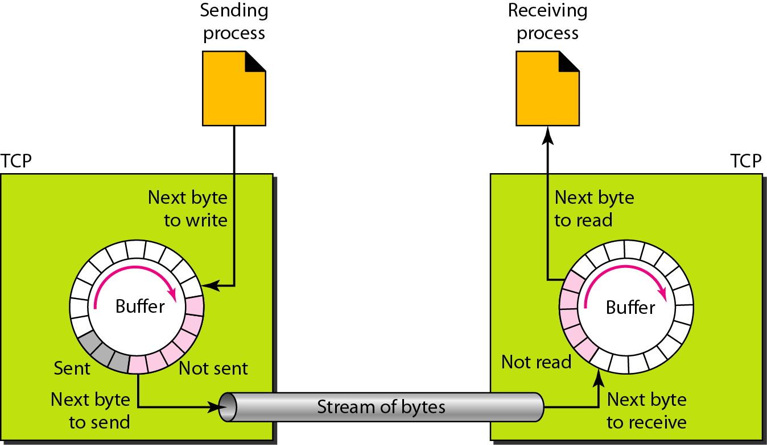
Figure 23.14 Sending and receiving buffers

Slide 36
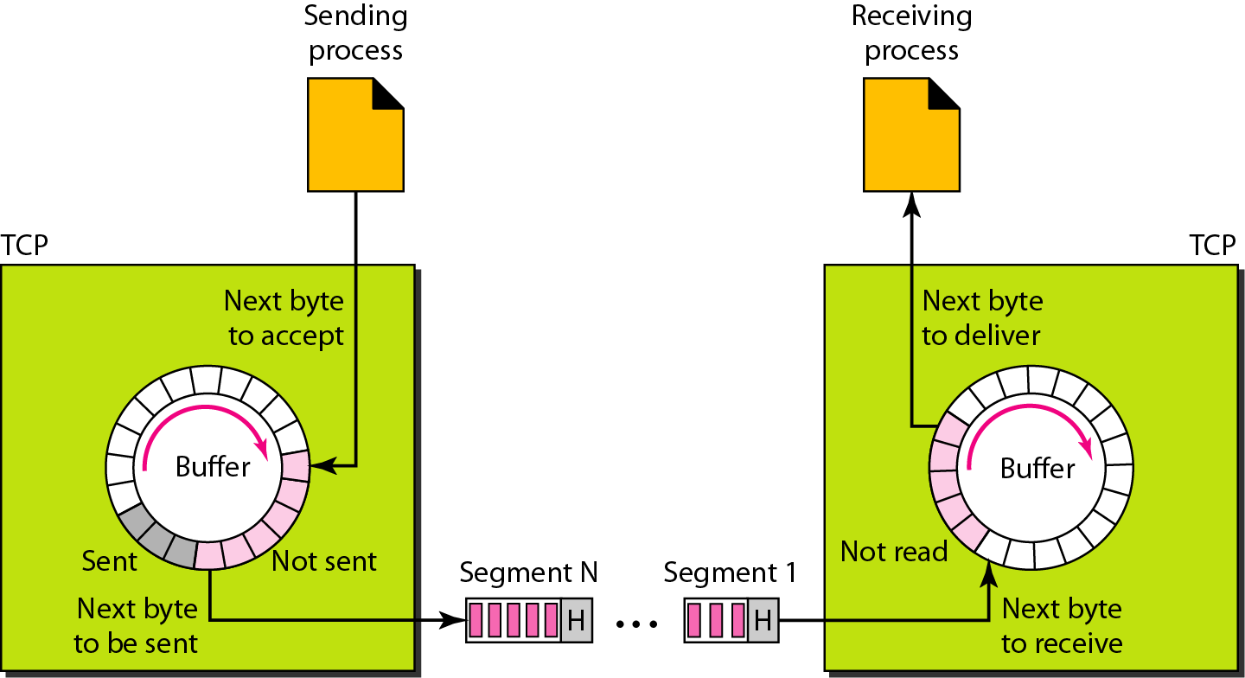
Figure 23.15 TCP segments

Slide 37
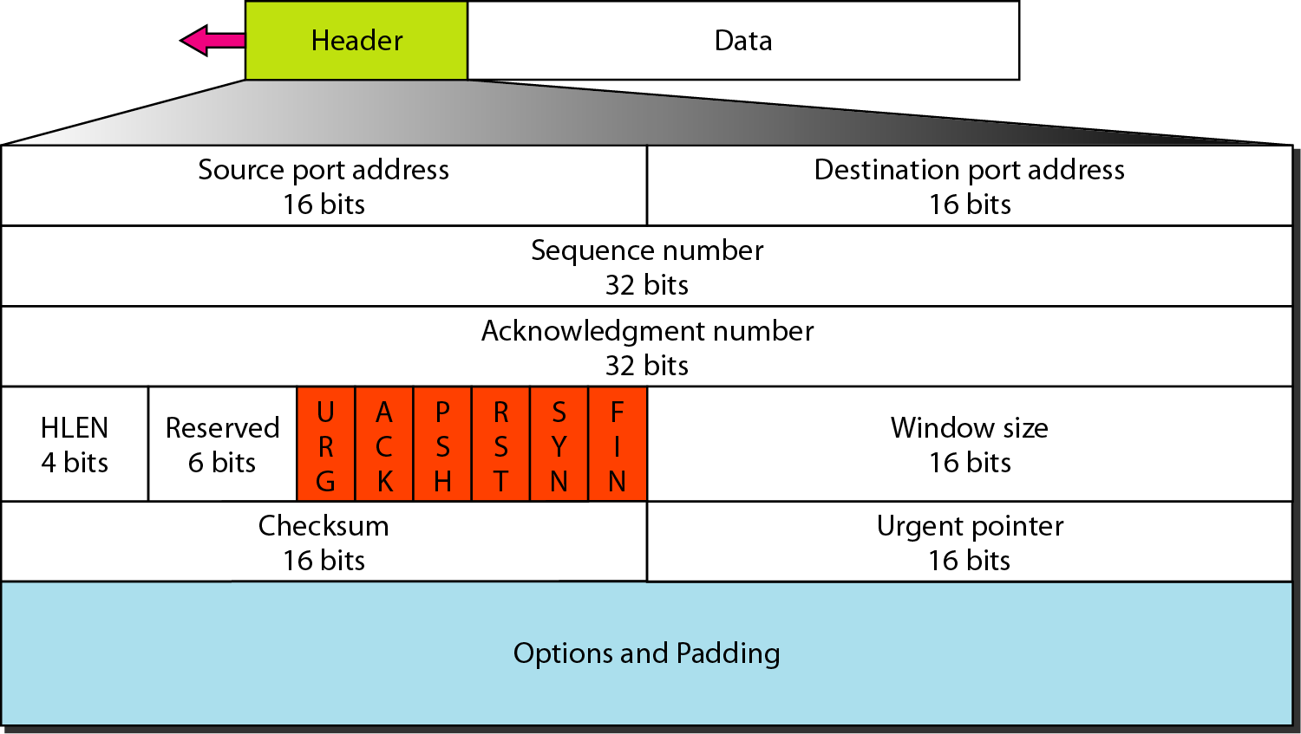
Figure 23.16 TCP segment format

Slide 38
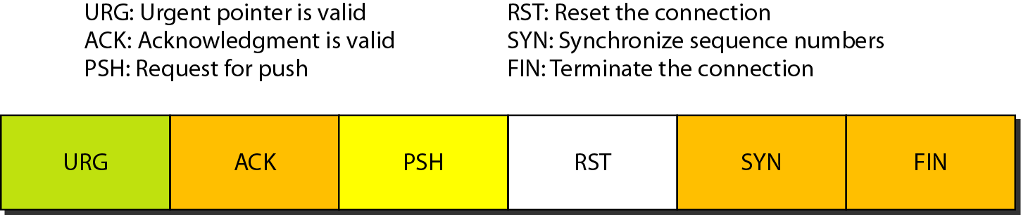
Figure 23.17 Control field

Slide 39
Table 23.3 - Description of flags in the control field .

Slide 40
Working of TCP.
In TCP, the connection is established or organized by using three-way handshaking. The client sends the segment with its sequence number. The server, in return, sends its segment with its own sequence number as well as the acknowledgment sequence, which is one more than the client sequence number. When the client receives the acknowledgment of its segment, then it sends the acknowledgment to the server. In this way, the connection is established between the client and the server.

Slide 41
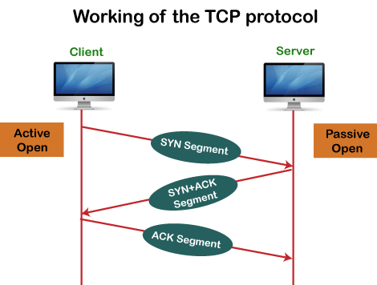
Working of TCP Protocol

Slide 42
SYN Segment , SYN +ACK, ACK.
A SYN segment cannot carry data, but it consumes one sequence number.
A SYN + ACK segment cannot carry data but does consume one sequence number.
An ACK segment, if carrying no data, consumes no sequence number.

Slide 43
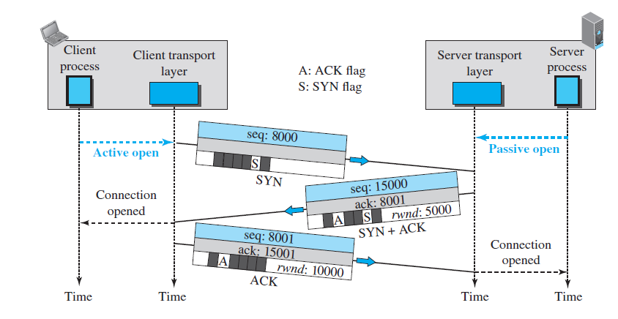
Figure 23.18- Connection establishment using three-way handshaking.

Slide 44
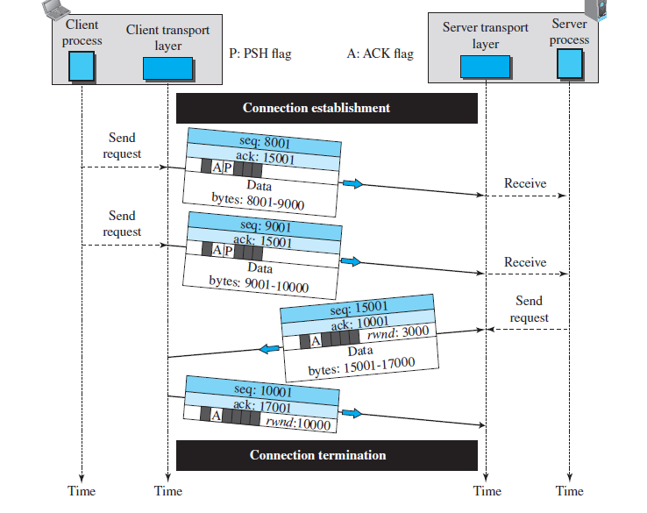
Figure 23.19 Data transfer

Slide 45
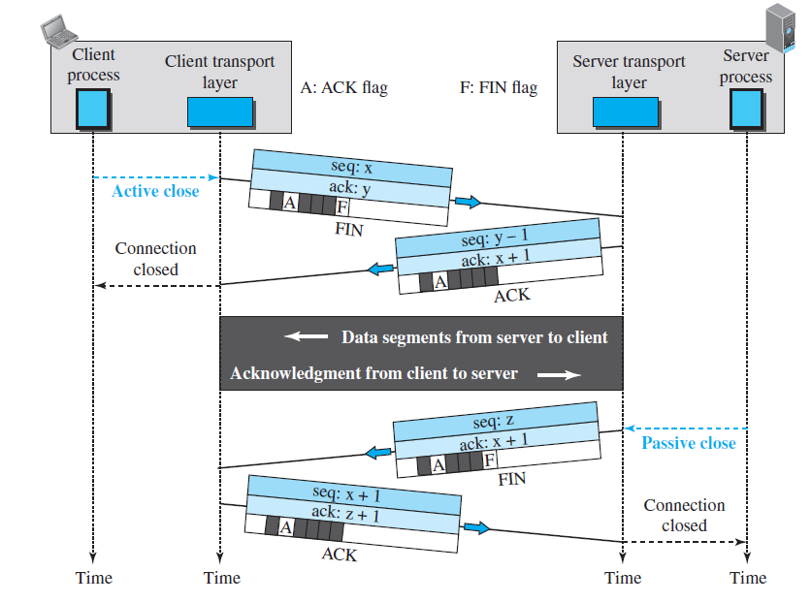
Figure 23.21 Half-close .

Slide 46
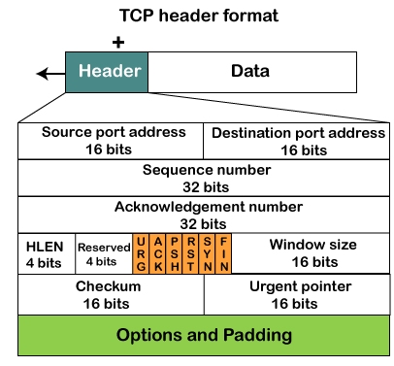
TCP Header Format.

Slide 47
TCP Header Format.
Source port: It defines the port of the application, which is sending the data. So, this field contains the source port address, which is 16 bits.
Destination port: It defines the port of the application on the receiving side. So, this field contains the destination port address, which is 16 bits.
Sequence number: This field contains the sequence number of data bytes in a particular session.
Acknowledgment number: When the ACK flag is set, then this contains the next sequence number of the data byte and works as an acknowledgment for the previous data received. For example, if the receiver receives the segment number 'x', then it responds 'x+1' as an acknowledgment number.
HLEN: It specifies the length of the header indicated by the 4-byte words in the header. The size of the header lies between 20 and 60 bytes. Therefore, the value of this field would lie between 5 and 15.
Reserved: It is a 4-bit field reserved for future use, and by default, all are set to zero.

Slide 48
Flags
There are six control bits or flags:
URG: It represents an urgent pointer. If it is set, then the data is processed urgently.
ACK: If the ACK is set to 0, then it means that the data packet does not contain an acknowledgment.
PSH: If this field is set, then it requests the receiving device to push the data to the receiving application without buffering it.
RST: If it is set, then it requests to restart a connection.
SYN: It is used to establish a connection between the hosts.
FIN: It is used to release a connection, and no further data exchange will happen.
Window size -
It is a 16-bit field. It contains the size of data that the receiver can accept. This field is used for the flow control between the sender and receiver and also determines the amount of buffer allocated by the receiver for a segment. The value of this field is determined by the receiver.
Checksum-
It is a 16-bit field. This field is optional in UDP, but in the case of TCP/IP, this field is mandatory.
Urgent pointer-
It is a pointer that points to the urgent data byte if the URG flag is set to 1. It defines a value that will be added to the sequence number to get the sequence number of the last urgent byte.
Options -
It provides additional options. The optional field is represented in 32-bits. If this field contains data less than 32-bit, then padding is required to obtain the remaining bits.

Slide 49
Advantages of TCP.
It provides a connection-oriented reliable service, which means that it guarantees the delivery of data packets. If the data packet is lost across the network, then the TCP will resend the lost packets.
It provides a flow control mechanism using a sliding window protocol.
It provides error detection by using checksum and error control by using Go Back or ARP protocol.
It eliminates the congestion by using a network congestion avoidance algorithm that includes various schemes such as additive increase/multiplicative decrease (AIMD), slow start, and congestion window.

Slide 50
Disadvantage of TCP.
It increases a large amount of overhead as each segment gets its own TCP header, so fragmentation by the router increases the overhead.

Slide 51
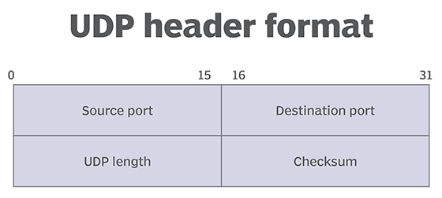
UDP Header format.

Slide 52
UDP header.
UDP uses headers when packaging message data to transfer over network connections. UDP headers contain a set of parameters -- called fields -- defined by the technical specifications of the protocol.
The User Datagram Protocol header has four fields, each of which is 2 bytes. They are the following:
source port number, which is the number of the sender; destination port number, the port to which the datagram is addressed; length, the length in bytes of the UDP header and any encapsulated data; and checksum, which is used in error checking -- its use is required in IPv6 and optional in IPv4.

Slide 53
Advantage of UDP .
Advantages of UDP :
UDP does not need to require a connection to be established and maintained.
UDP uses a small packet size with a small header. This fewer bytes in the overhead makes UDP protocol need for less time in processing the packet as well as needless memory.
UDP uses checksum with all packets for error detection.
UDP can be used in events where a single packet of data needs to be exchanged between the hosts.
Broadcast and multicast transmission are available with UDP

Slide 54


